Slide 1

Forecasting Consumer Spending Amounts Using Machine Learning and Time Series Analysis
Roy
20241007

Slide 2
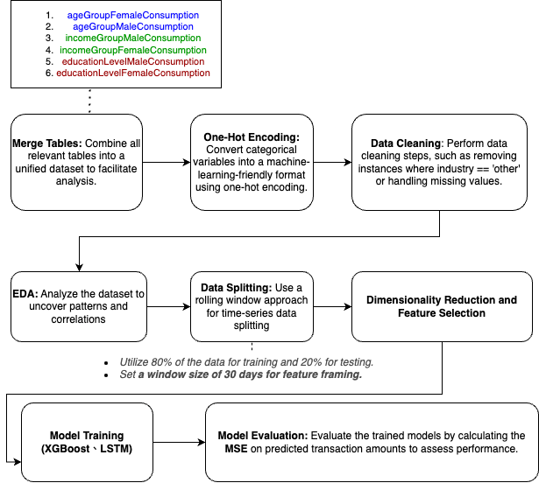
Merge Tables -> One-Hot Encoding -> Data Cleaning -> Exploratory Data Analysis (EDA) -> Data Splitting -> Feature Selection -> Model Training -> Model Evaluation
Flow chart
IDA Template

Slide 3
Data (data.gov.tw)
ageGroupFemaleConsumption：各年齡層女性持卡人於各行業別總簽帳金額及筆數
ageGroupMaleConsumption：各年齡層男性持卡人於各行業別總簽帳金額及筆數
incomeGroupMaleConsumption：各年收入族群男性持卡人於各行業別總簽帳金額及筆數
incomeGroupFemaleConsumption：各年收入族群女性持卡人於各行業別總簽帳金額及筆數
educationLevelMaleConsumption：各教育程度男性持卡人於六都消費樣態
educationLevelFemaleConsumption：各教育程度女性持卡人於六都消費樣態
IDA Template

Slide 4
Merge Tables -> One-Hot Encoding -> Data Cleaning -> Exploratory Data Analysis (EDA) -> Data Splitting -> Feature Selection -> Model Training -> Model Evaluation
IDA Template

Slide 5
Merge Tables -> One-Hot Encoding -> Data Cleaning -> Exploratory Data Analysis (EDA) -> Data Splitting -> Feature Selection -> Model Training -> Model Evaluation
IDA Template

Slide 6
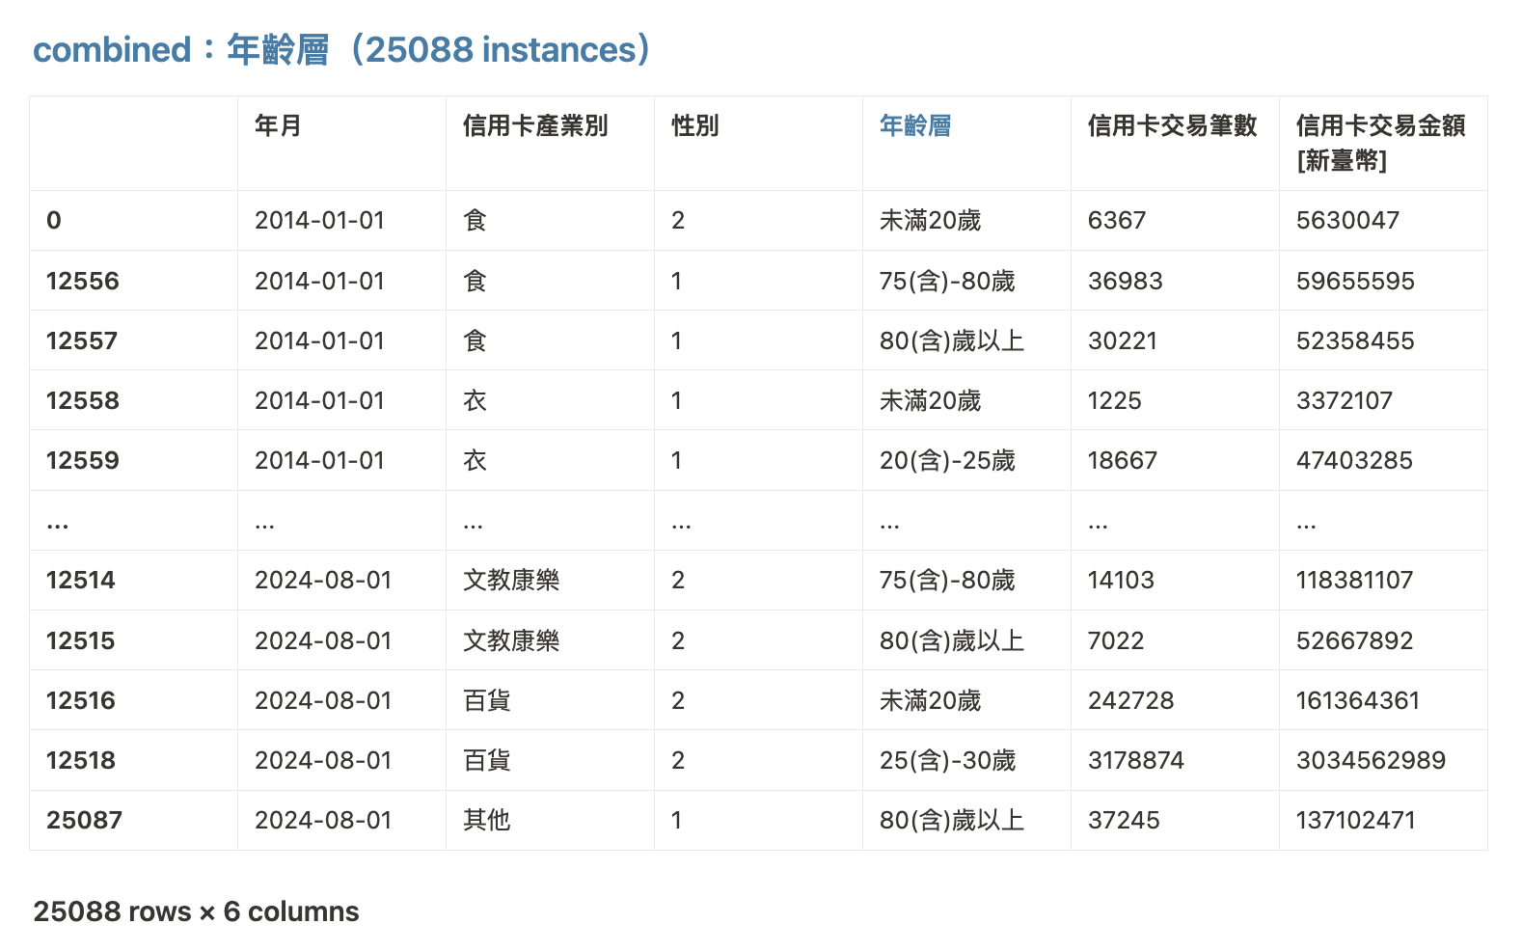
Merge Tables -> One-Hot Encoding -> Data Cleaning -> Exploratory Data Analysis (EDA) -> Data Splitting -> Feature Selection -> Model Training -> Model Evaluation
Merged table：Age Group
IDA Template

Slide 7
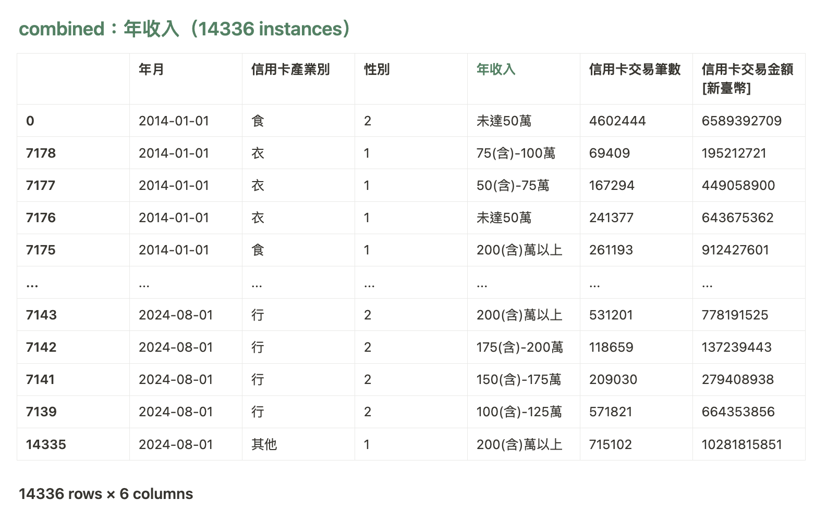
Merge Tables -> One-Hot Encoding -> Data Cleaning -> Exploratory Data Analysis (EDA) -> Data Splitting -> Feature Selection -> Model Training -> Model Evaluation
Merged table：Income Group
IDA Template

Slide 8
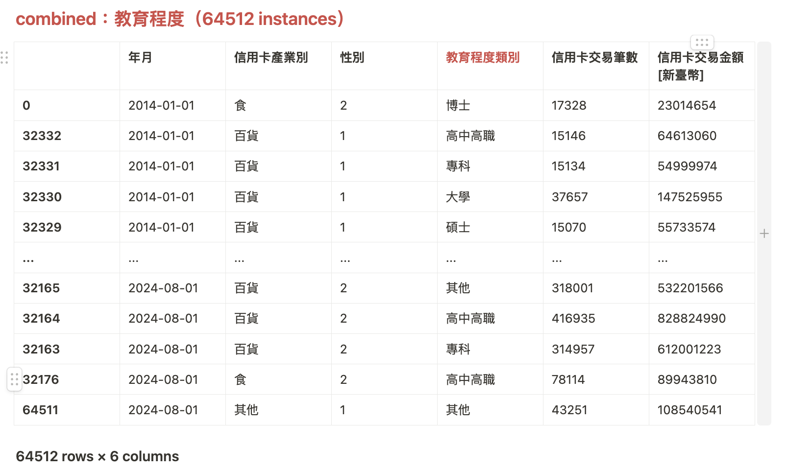
Merge Tables -> One-Hot Encoding -> Data Cleaning -> Exploratory Data Analysis (EDA) -> Data Splitting -> Feature Selection -> Model Training -> Model Evaluation
Merged table：Education Level
IDA Template

Slide 9
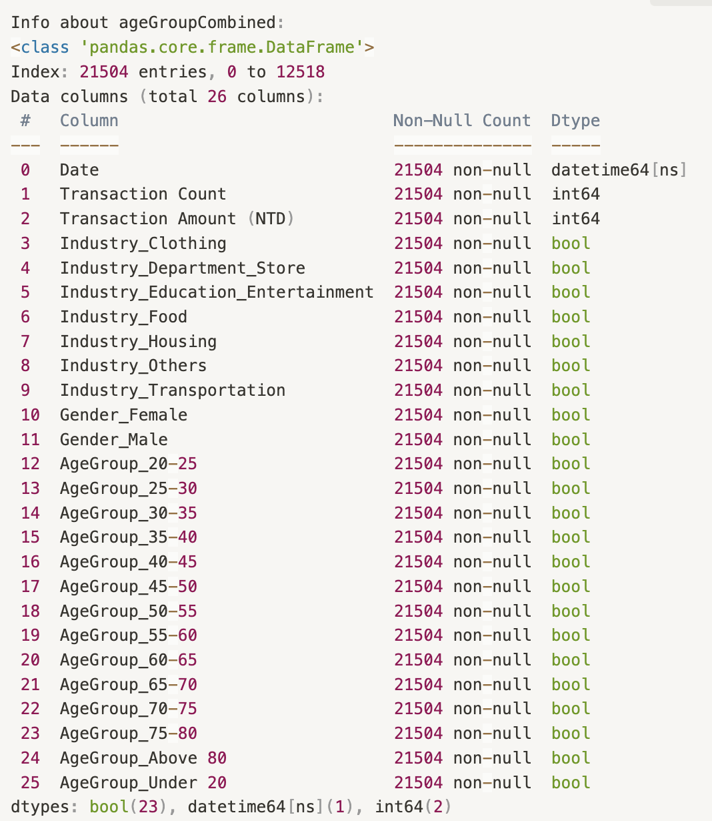
Merge Tables -> One-Hot Encoding -> Data Cleaning -> Exploratory Data Analysis (EDA) -> Data Splitting -> Feature Selection -> Model Training -> Model Evaluation
One-hot encoding：age group
IDA Template

Slide 10
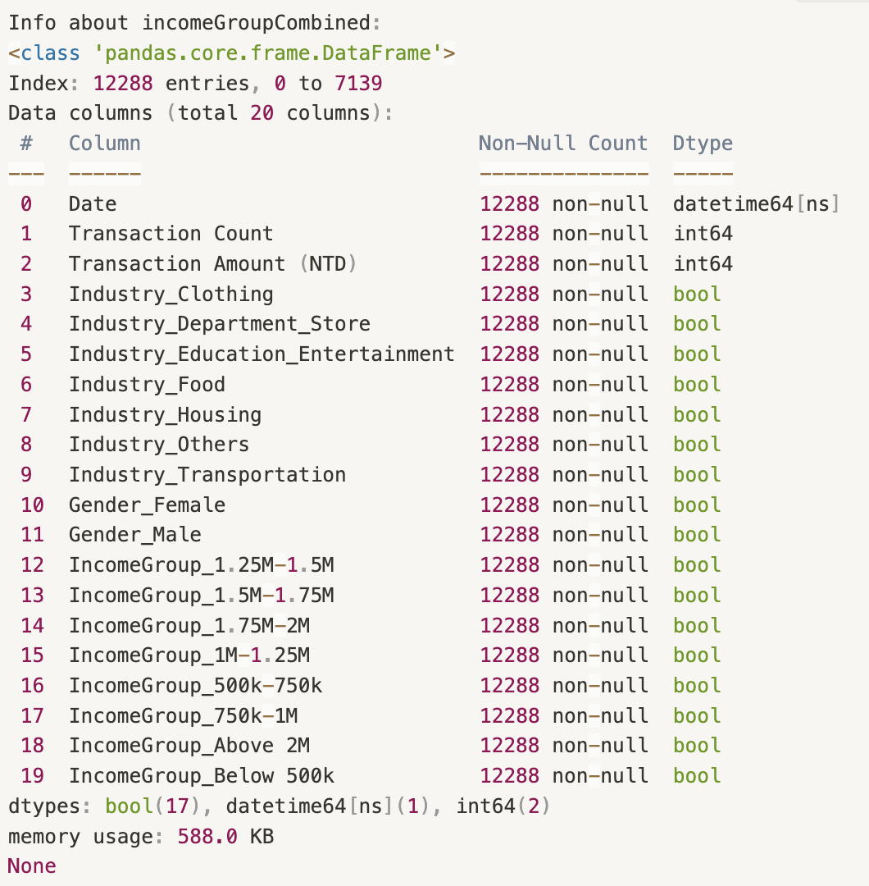
Merge Tables -> One-Hot Encoding -> Data Cleaning -> Exploratory Data Analysis (EDA) -> Data Splitting -> Feature Selection -> Model Training -> Model Evaluation
One-hot encoding：income group
IDA Template

Slide 11
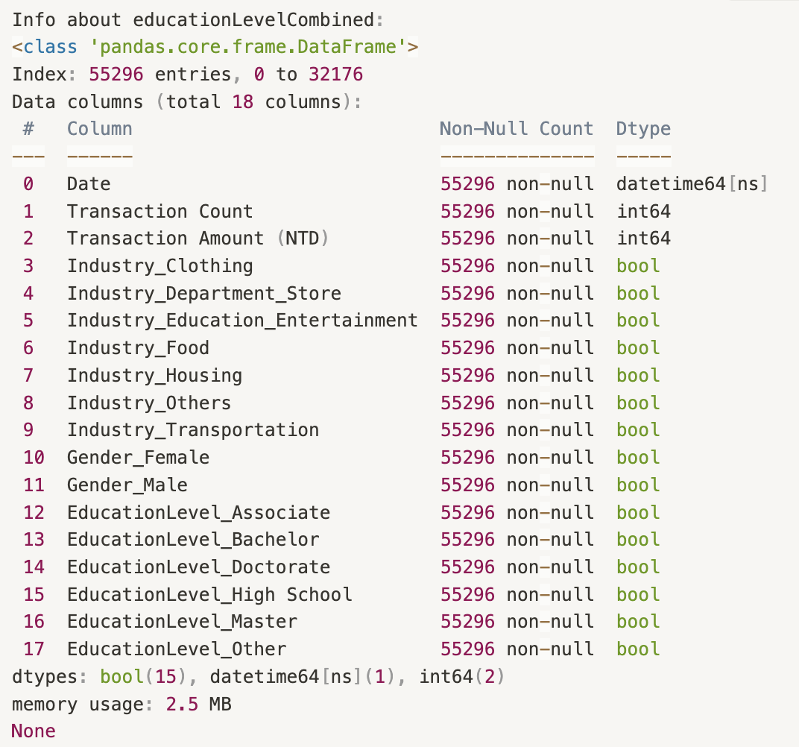
Merge Tables -> One-Hot Encoding -> Data Cleaning -> Exploratory Data Analysis (EDA) -> Data Splitting -> Feature Selection -> Model Training -> Model Evaluation
One-hot encoding：education level
IDA Template

Slide 12
Merge Tables -> One-Hot Encoding -> Data Cleaning -> Exploratory Data Analysis (EDA) -> Data Splitting -> Feature Selection -> Model Training -> Model Evaluation
Data cleaning
IDA Template

Slide 13
Merge Tables -> One-Hot Encoding -> Data Cleaning -> Exploratory Data Analysis (EDA) -> Data Splitting -> Feature Selection -> Model Training -> Model Evaluation
EDA
Do key variables (e.g., Age, Income, Education) significantly impact the target variable (transaction amount)?
Do industries influence the relationship between key variables and the target?
Does the distribution of industries across different key variables show consistent patterns in their contribution to transaction amounts?
Does the target variable exhibit any cyclical patterns over time?
IDA Template

Slide 14
Merge Tables -> One-Hot Encoding -> Data Cleaning -> Exploratory Data Analysis (EDA) -> Data Splitting -> Feature Selection -> Model Training -> Model Evaluation
EDA
Correlation and Distribution Analysis of Individual Variables with Transaction Amounts
Correlation and Distribution Analysis of Industry Categories with Transaction Amounts
Impact of Key Variables (Age, Income, Education) and Industry Categories on Transaction Amounts
Time Series Analysis to Identify Cycles and Evaluate the Importance of Dates for Accurate Data Splitting
IDA Template

Slide 15
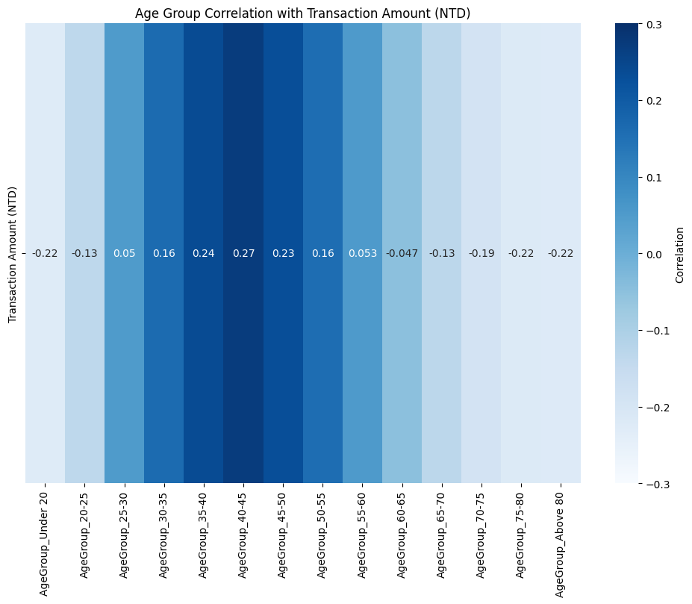
Merge Tables -> One-Hot Encoding -> Data Cleaning -> Exploratory Data Analysis (EDA) -> Data Splitting -> Feature Selection -> Model Training -> Model Evaluation
EDA：age group
Correlation and Distribution Analysis of Individual Variables with Transaction Amounts
IDA Template

Slide 16
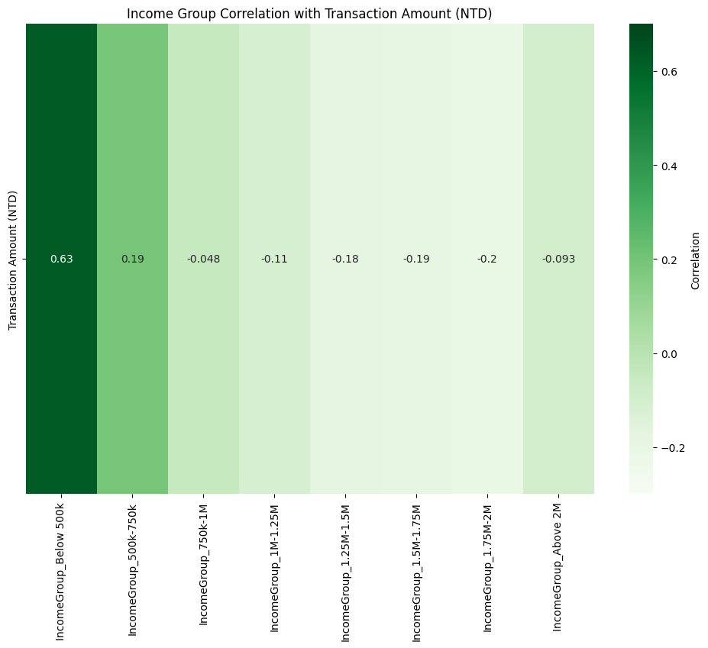
Merge Tables -> One-Hot Encoding -> Data Cleaning -> Exploratory Data Analysis (EDA) -> Data Splitting -> Feature Selection -> Model Training -> Model Evaluation
EDA：income group
Correlation and Distribution Analysis of Individual Variables with Transaction Amounts
IDA Template

Slide 17
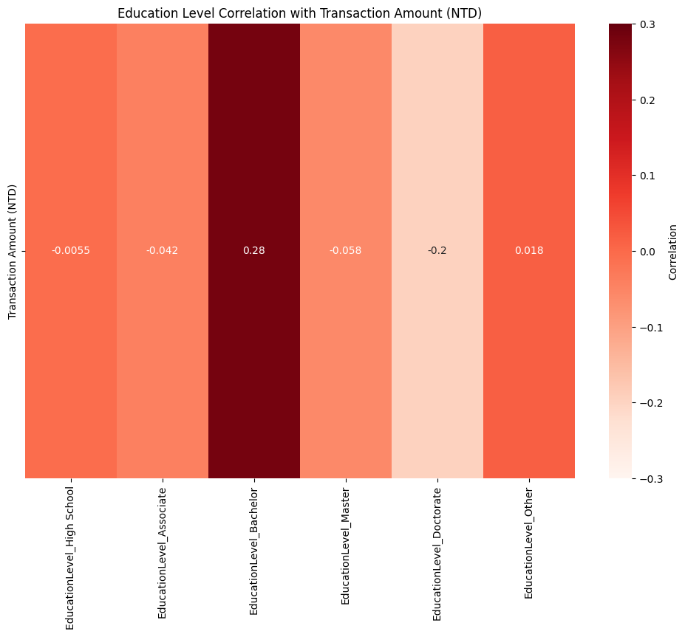
Merge Tables -> One-Hot Encoding -> Data Cleaning -> Exploratory Data Analysis (EDA) -> Data Splitting -> Feature Selection -> Model Training -> Model Evaluation
EDA：education level
Correlation and Distribution Analysis of Individual Variables with Transaction Amounts
IDA Template

Slide 18
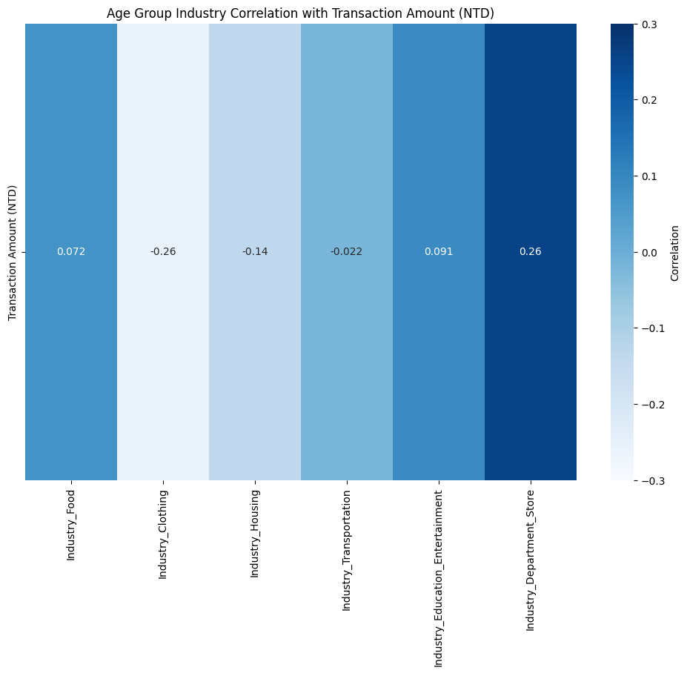
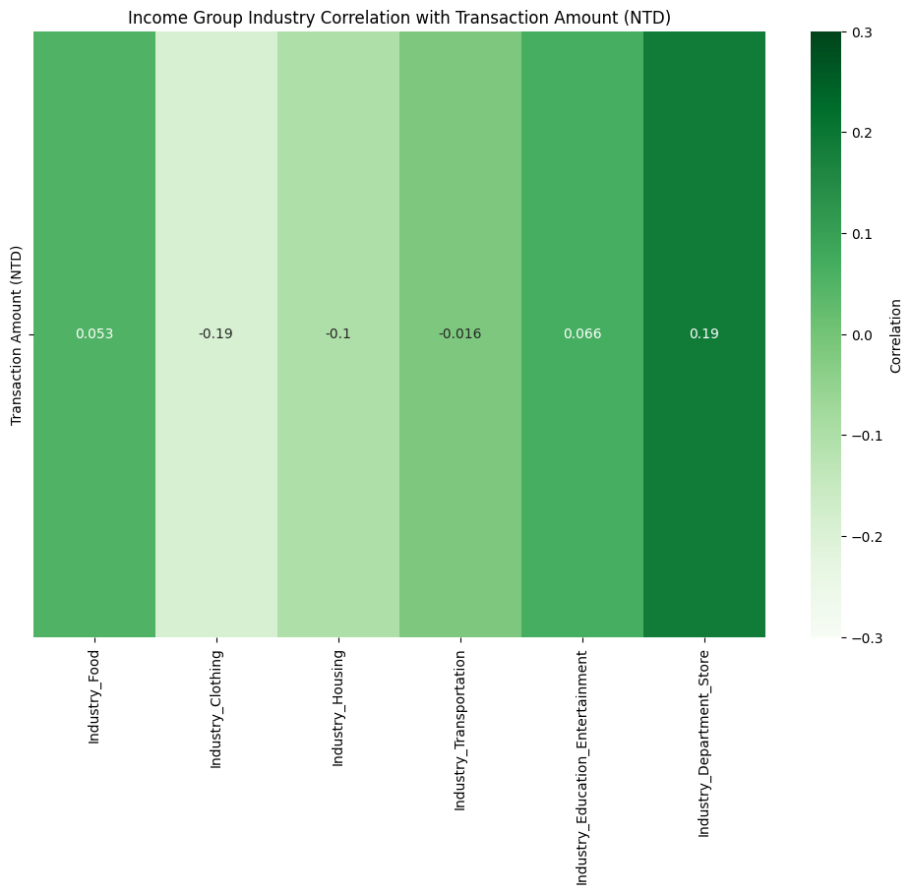
Merge Tables -> One-Hot Encoding -> Data Cleaning -> Exploratory Data Analysis (EDA) -> Data Splitting -> Feature Selection -> Model Training -> Model Evaluation
EDA：
2. Correlation and Distribution Analysis of Industry Categories with Transaction Amounts
IDA Template

Slide 19
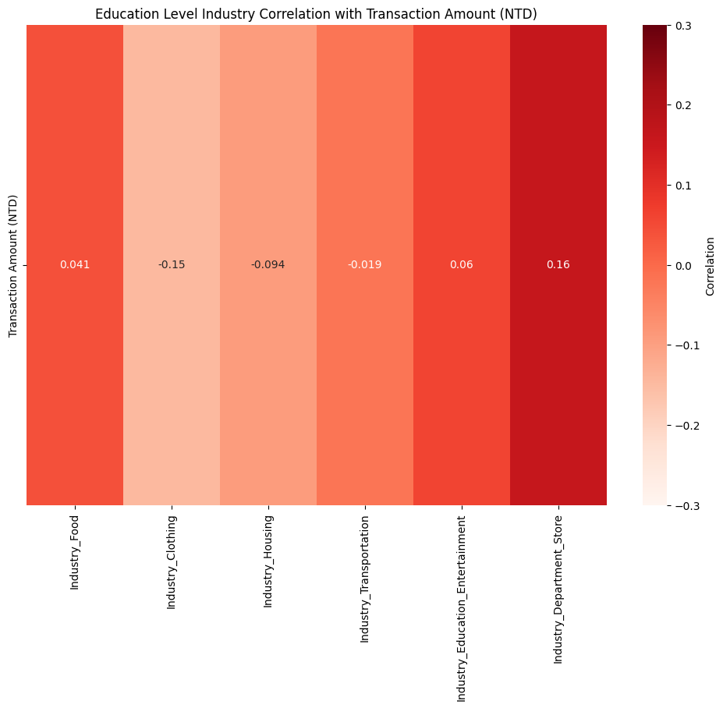
Merge Tables -> One-Hot Encoding -> Data Cleaning -> Exploratory Data Analysis (EDA) -> Data Splitting -> Feature Selection -> Model Training -> Model Evaluation
EDA：
2. Correlation and Distribution Analysis of Industry Categories with Transaction Amounts
IDA Template

Slide 20
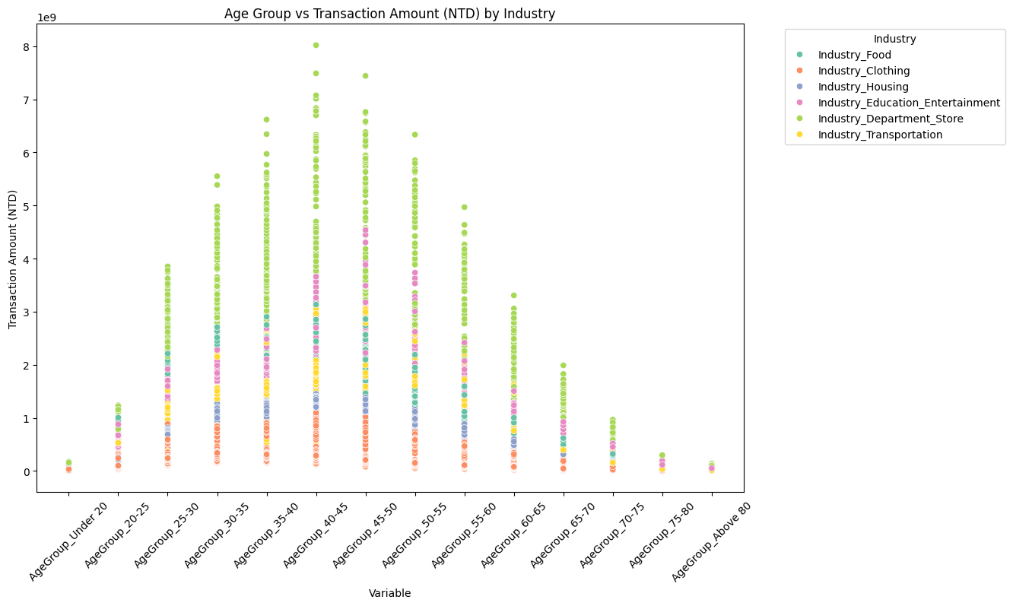
Merge Tables -> One-Hot Encoding -> Data Cleaning -> Exploratory Data Analysis (EDA) -> Data Splitting -> Feature Selection -> Model Training -> Model Evaluation
EDA：age group
3. Impact of Key Variables (Age, Income, Education) and Industry Categories on Transaction Amounts
IDA Template

Slide 21
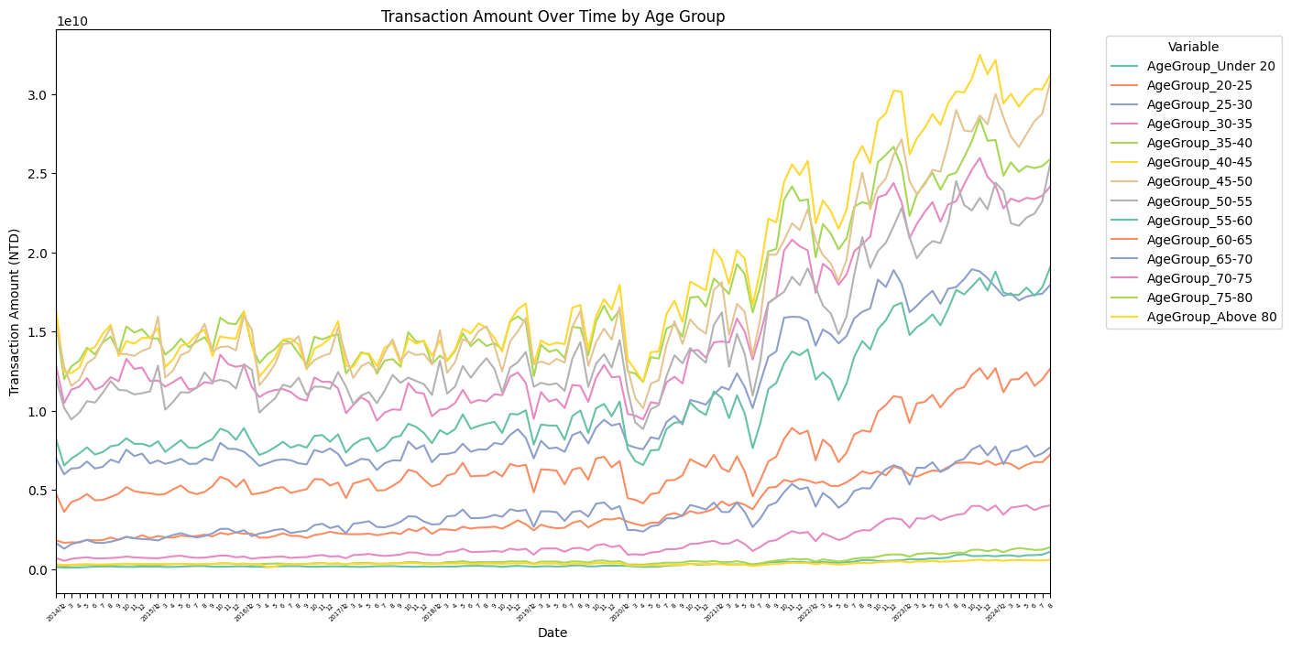
Merge Tables -> One-Hot Encoding -> Data Cleaning -> Exploratory Data Analysis (EDA) -> Data Splitting -> Feature Selection -> Model Training -> Model Evaluation
EDA：age group
4. Time Series Analysis to Identify Cycles and Evaluate the Importance of Dates for Accurate Data Splitting
IDA Template

Slide 22
Merge Tables -> One-Hot Encoding -> Data Cleaning -> Exploratory Data Analysis (EDA) -> Data Splitting -> Feature Selection -> Model Training -> Model Evaluation
Data Splitting
Utilize 80% of the data for training and 20% for testing.
Set a window size of 30 days for feature framing.
 | date | f2 | f3 | … | fn | target
x1
x2
…
x30
x31 |  |  |  |  |  | target
IDA Template

Slide 23
Merge Tables -> One-Hot Encoding -> Data Cleaning -> Exploratory Data Analysis (EDA) -> Data Splitting -> Feature Selection -> Model Training -> Model Evaluation
Data selection
Top feature names: [
'Transaction Count_t-29’,
'Transaction Count_t-28’,
'AgeGroup_45-50_t-29’,
'AgeGroup_40-45_t-29’,
'AgeGroup_35-40_t-29’,
'Industry_Department_Store_t-22', 'Industry_Department_Store_t-29’,
'AgeGroup_30-35_t-29’,
'AgeGroup_50-55_t-29’,
'Industry_Department_Store_t-21']
Correlation values: [0.21883816467937536, 0.12935893926542502, 0.09250959148474633, 0.09097169679091024, 0.08300890956894194, 0.07668582728125771, 0.07527391774477073, 0.0733772624264886, 0.07300706512182722, 0.07223371419053244]
IDA Template

Slide 24
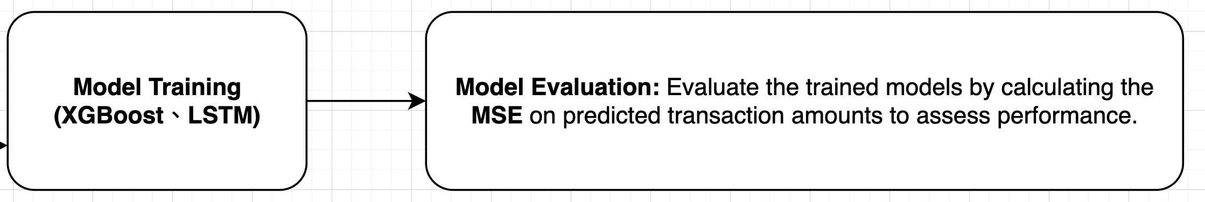
Merge Tables -> One-Hot Encoding -> Data Cleaning -> Exploratory Data Analysis (EDA) -> Data Splitting -> Feature Selection -> Model Training -> Model Evaluation
Model training
3 DataFrames(age,income,education level) * 2 models
with MSE to evaluate the best features and model
to predict the consumers behaviors

